Slide 1



Nico
Rafael
Emergency Department
Wait-time analysis
A healthcare analytics investigation into ER wait times, using synthetic datasets modeled after Las Vegas hospitals.

Slide 2


Problem & Goal
Leadership at the Valley Regional Medical Center has requested to investigate and present findings regarding extensive wait-times in their Emergency Department.
The goal is to reveal the average ER wait-times, busy hours of the day/week, and relations between patient severity levels and wait-times.
Additionally, I simulated follow up questions/ answers from the stakeholders.

Slide 3






Tools Used

Slide 4

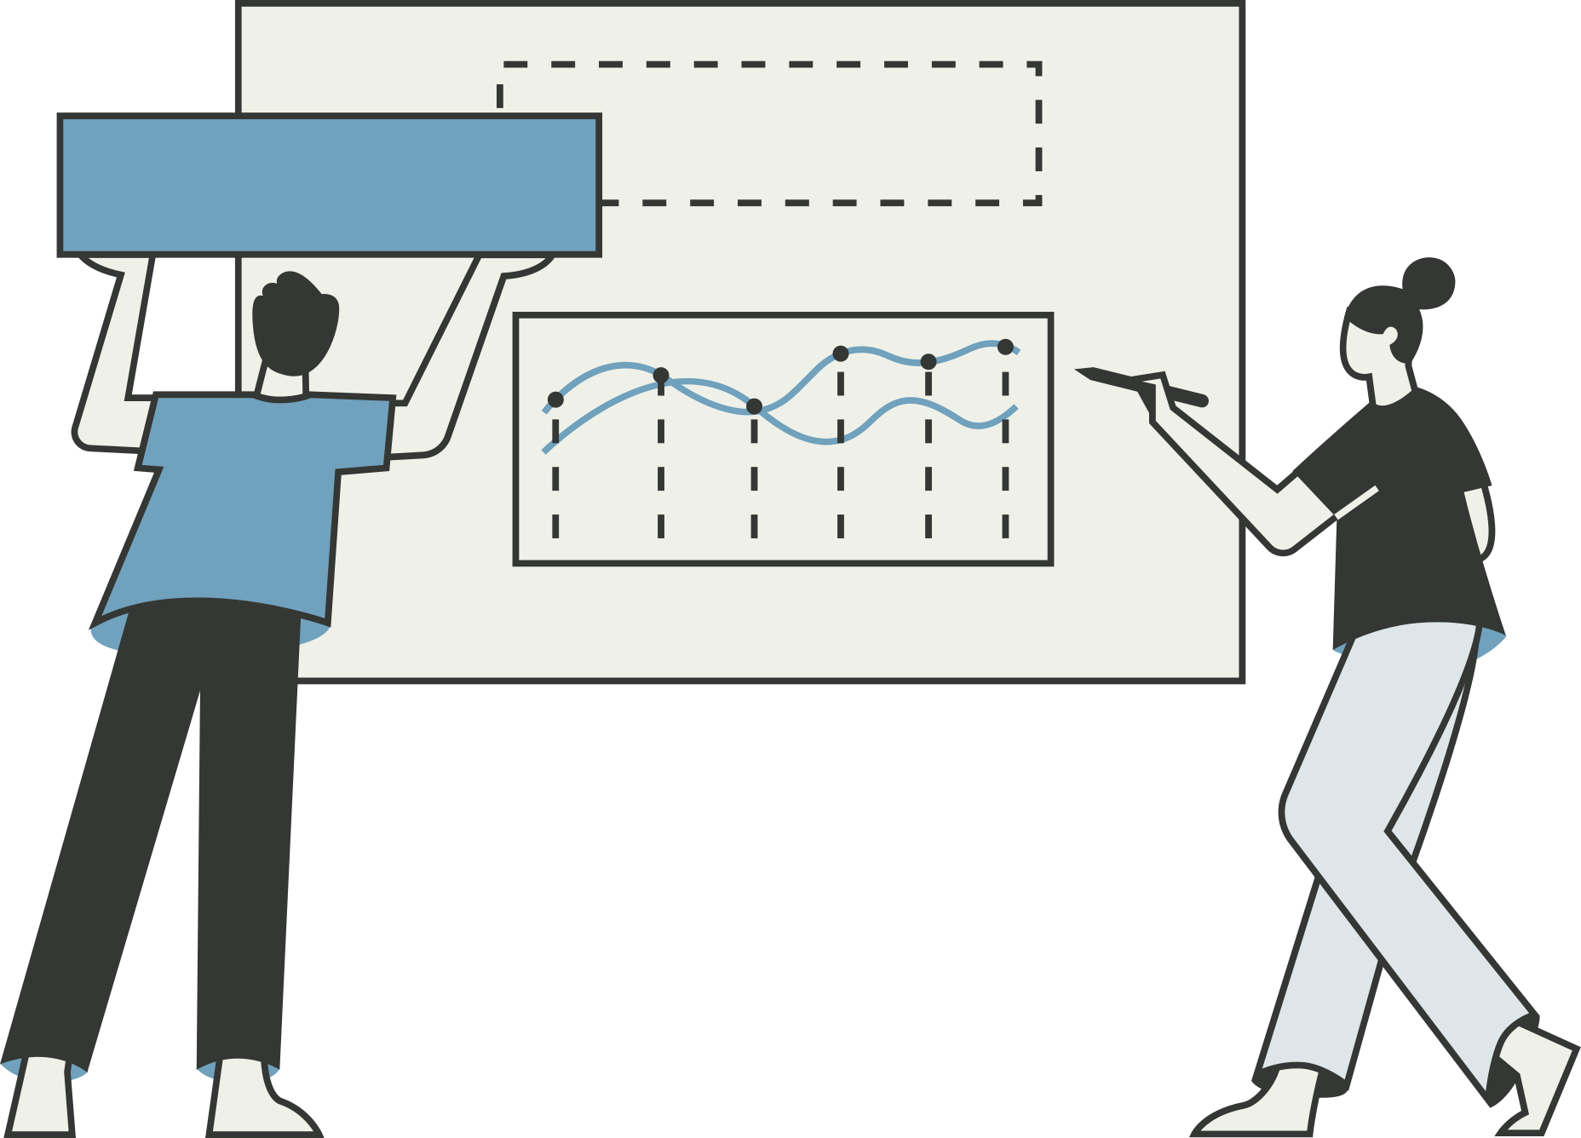
SQL & Modeling Workflow
Designed Entity Relationship Diagram
Created tables in SQL
Imported CSVs: ER visits, appointments, patients, and providers
Standardized providers names within dataset
Conduct exploratory SQL analysis
Exported aggregated tables for visualization

Slide 5
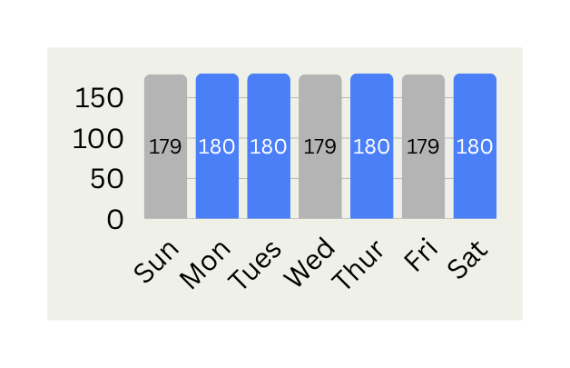
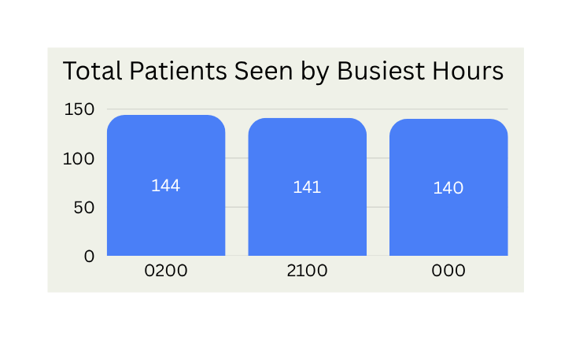
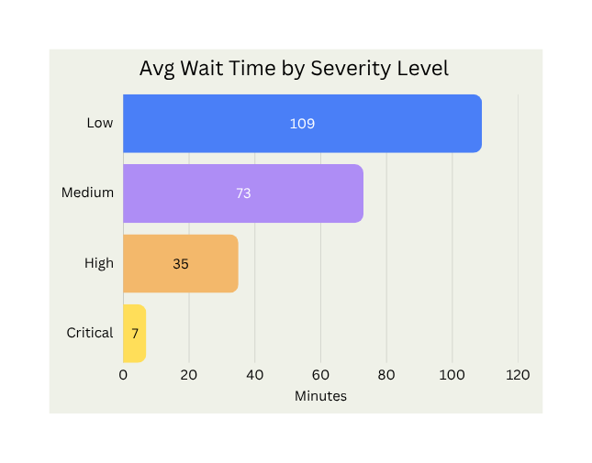
Insights
74 min
67 min
5
5
Avg
Wait
Median
Wait
Longest Wait-Time Experienced
180 min on Mondays, Tuesdays, Thursdays, and Saturdays
Busiest Hours
12 AM
71% of Visits During Peak Periods
2 AM
Generated by Medium- and Low-severity patients
9 PM

Slide 6
Business Recommendations
Ensuring High‑Acuity Focus While Optimizing Lower‑Acuity Flow
Evaluate staffing and patient flow during peak demand periods: Monday, Tuesday, Thursday, and Saturday, at 12 AM, 2 AM, and 9 PM.
Continue prioritizing Critical- and High-severity patients through the current triage process. This is working good. Monitor Low and Medium-severity patient flow to identify opportunities for operational improvements.

Slide 7
Impact
This analysis equipped stakeholders with clear operational signals behind prolonged wait times, enabling them to pursue targeted follow‑up questions and make more informed, data‑driven decisions about staffing, peak‑period capacity, and patient flow.

Slide 8




Follow Up Insights
After initial findings, stakeholders requested additional insight to determine causes of long wait-times in the emergency department
Patient Satisfaction
No-Shows
ER Volume
Wait - Times
24%
37%
45-64
Scores reamained stable across appointment types
Older Adult Male/Females from Henderson
Older Adult Females from Las Vegas
Henderson residents represent the largest share of visits to ER
Patients in these age ranges experience the longest waiting
Further investigation is needed to identify the operational drivers behind these trends

Slide 9
Turning Insights Into Action
While deeper investigation will refine the picture, these findings already give stakeholders clear direction for taking action on peak‑period capacity, staffing alignment, and patient flow.
Confirm operational bottlenecks through workflow analysis
Model peak-period capactiy and resoruce needs
Evaluate diagnositc and arrival patterns contributing to delays
Map patient journey through the ER to identify friction points

Slide 10


Thank You
Let’s build smarter decisions together
GitHub
LinkedIn
nrafael@gmail.com

